Slide 1
Array iN PHP

Slide 2
Introduction to Arrays
​In PHP, an array is a data structure that can store multiple values. Arrays can be indexed or associative, and are used to store related data. Understanding arrays is crucial for efficient data manipulation and storage in PHP.
​

Slide 3
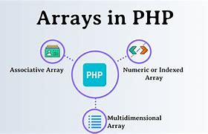

Slide 4
Types of Arrays 1. Indexed Arrays 2. Associative Arrays 3. Multidimensiona Arrays

Slide 5
Indexed arrays
Syntex:
$array_name = array(element1, element2, ...);
Example:
$colors = array("Red", "Green", "Blue");

Slide 6
Associative Arrays
Syntex:
$array_name = array(element1, element2, ...);
Example:
$person = array("name" => "John", "age" => 30, "city" => "New York");

Slide 7
Multidimensional arrays:
Syntex:
$multi_array_name = array(
array(element1, element2, ...),
array(element1, element2, ...),
// More arrays as needed
);
Example:
$matrix = array(
array(1, 2, 3),
array(4, 5, 6),
array(7, 8, 9)
);

Slide 8
THANK YOU
Do you have any questions?

